Slide 1
AMAZON :- SALES ANALYSIS
KEY SKILLS USED :- SQL

Slide 2
Overview Of Amazon Sales Data
The data consists of sales record of three cities/branch in Myanmar which are Naypyitaw, Yangon, Mandalay which took place in first quarter of year 2019 . The data consists of 1000 rows and 17 columns.
Objective of Project
The major aim of this project is to gain insight into the sales data of Amazon to understand the different factors that affect sales of the different branches

Slide 3
Preview of Amazon Sales Data
Column | Description | Data Type
Invoice Id | Invoice of the sales made | Varchar(30)
Branch | Branch at which sales were made | Varchar(5)
City | The location of the branch | Varchar(30)
Customer Type | The type of the customer | Varchar(30)
Gender | Gender of the customer making purchase | Varchar(10)
Product Line | Product line of the product sold | Varchar(100)
Unit Price | The price of each product | Decimal(10,2)
Quantity | The amount of the product sold | Int
VAT | The amount of tax on the purchase | Float
Total | The total cost of the purchase | Decimal(10,2)
Date | The date on which the purchase was made | Date
Time | The time at which the purchase was made | Time
Payment Method | The total amount paid | Varchar(15)
Cogs | Cost Of Goods sold | Decimal(10,2)
Gross Margin Percentage | Gross margin percentage | Float
Gross Income | Gross Income | Decimal(10,2)
Rating | Rating | Decimal(3,1)

Slide 4
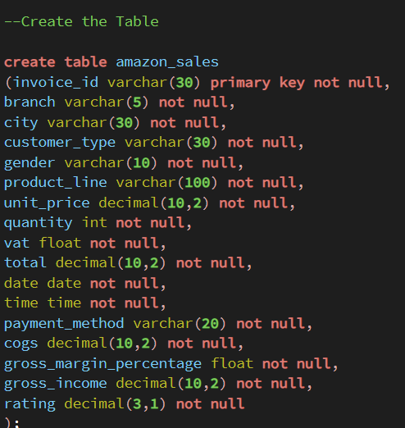
Exploratory Data Analysis
Step [1]: Creating new table named Amazon Sales by adding correct column
names, datatypes, constraints while copying values from demo table Amazon.

Slide 5
Business Problem
What is the count of distinct cities in the dataset?
each branch, what is the corresponding city?
What is the count of distinct product lines in the dataset?
Which payment method occur most frequently?
Which product lines has the highest sales?
How much revenue is generated each month?
Which product line generated the highest revenue?
In which city was the highest revenue recorded?
Which product line incurred the highest Value Added Tax?
For each product line, add a column indicating "Good" if its sales are above average, otherwise "Bad."
Identify the branch that exceeded the average number of products sold.

Slide 6
Which product line is most frequently associated with each gender?
Calculate the average rating for each product line.
Count the sales occurrences for each time of day on every weekday.
Identify the customer type contributing the highest revenue.
Determine the city with the highest VAT percentage.
Identify the customer type with the highest VAT payments.
What is the count of distinct customer types in the dataset?
What is the count of distinct payment methods in the dataset?
Which customer type occurs most frequently?
Identify the time of day when customers provide the most ratings.

Slide 7
Key Findings
Product Analysis:
Highest Sales Product Line: Electronic Accessories (Units Sold:971)
Highest Revenue Product Line: Food and Beverages ($ 56144.96)
Lowest Sales Product Line: Health and Beauty (Unit Sold: 854)
Lowest Revenue Product Line: Health and Beauty ($ 49193.84)
Sales Analysis:
Month With Highest Revenue: January ($ 116292.11)
City & Branch With Highest Revenue: Naypyitaw[C] ($ 110568.86)
Month With Lowest Revenue: February ($ 97219.58)
City & Branch With Lowest Revenue: Mandalay[B] ($ 106198.00)
Peak Sales Time Of Day: Afternoon
Peak Sales Day Of Week: Saturday

Slide 8
Customer Analysis:
Most Predominant Gender: Female
Most Predominant Customer Type: Member
Highest Revenue Gender: Female ($ 167883.26)
Highest Revenue Customer Type: Member ($ 164223.81)
Most Popular Product Line (Male): Health and Beauty
Most Popular Product Line (Female): Fashion Accessories
Distribution Of Members Based On Gender: Male(240) Female(261)
Sales Male: 2641 units
Sales Female: 2869 units

